Slide 1
Evidence: It’s How Judges Know Things

Slide 5
Evidence-
Based
Courts

Slide 6
“I like a smooth experience. That’s why I use Evidence!”

Slide 7
What is Evidence?
“Evidence” is any thing produced by a party in court as a means of establishing a factual claim.

Slide 8
Proof
“Proof” is the process of using evidence to establish a factual claim to the relevant degree of certainty.

Slide 9
Judicial Knowledge of Facts
In any hearing or trial, judges may use only those facts presented by the parties at that hearing or trial to reach legal conclusions.
Facts are adduced by:
Sworn testimony
Properly-introduced document or exhibit
Stipulation
Judicial Notice
Notes:
The Four Way Test (not the Rotary version).

Slide 10
Adult Learning Moment
The Four-Way Test for court consideration:
Sworn testimony
Properly-introduced document or exhibit
Stipulation
Judicial Notice
All Together: “The court may never consider any fact that has not reached it by one of the Four Ways”.
Notes:
The Four Way Test (not the Rotary version).

Slide 11
Remember The Four Ways

Slide 12
The following do not constitute evidence and may not be relied upon by a court:
Conversations with the court by parties or their counsel, even on the record (unless these constitute stipulations). (ITIO C.H., 343 Ga. App. 1 (2017))
Unsworn statements by foster parents (or anyone else).
Documents which have not been introduced (CASA reports, court orders, e.g.).
The judge’s recollection or notes of what happened in a prior hearing.

Slide 13
“The Juvenile Code clearly contemplates that witnesses must be sworn and subject to cross-examination, hearsay will not be allowed (unless under a statutory exception), parties have the right to confront witnesses, and rules of evidence regarding the introduction of exhibits should be followed. Like the right to counsel, these rights are not optional.” ITIO C.H., 343 Ga. App. 1, 13 (2017)

Slide 14
Judge Calling Witnesses
The court may, on its own motion, call a court appointed expert, call a witness regarding the competency of any party, or call a child witness or, at the suggestion of a party, call such witnesses, and all parties shall be entitled to cross-examine such witnesses. In all other situations, the court may only call witnesses when there is an agreement of all of the parties for the court to call such witnesses and all parties shall be entitled to cross-examine such witnesses. Rule 614

Slide 15
Stipulations
A stipulation is a type of evidence, and so must either be in writing or on the record, and very detailed.
Parties may not stipulate to legal conclusions - only to facts.
Statements by counsel in place are considered evidence unless verification is required by the court or a party.
A party may stipulate solely to admissibility without waiving the right to further examination on that evidence.
A stipulation may not be forced upon another party as a means of precluding further examination.
Notes:
(insert case)
Statements in place… (Sherman v. City of Atlanta, 293 Ga. 169, 174 (2013))
Solely to admissibility… this is why stipulations need to be very precise and on the record. Stipulations are treated under contract theory… what did the party agree to? If a stipulation by more than one party, what did the parties agree to, specifically?
Forced on party… (Reed. v. State, 249 Ga. 52, 57 (1982))

Slide 16
Stipulations
A consent to termination of parental rights (like a surrender of parental rights) must be in writing and reviewed by the court do determine whether it has been entered freely, voluntarily, and knowingly. (See, OCGA §15-11-310(a)(1)
Notes:
15-11-310(a)(1) contains the “in writing” and “acknowledged by the court” language, which in context of the law regarding the waivers of substantial rights (e.g., right to counsel) must be reviewed on the record to determine freely, &c.
Essential that the written consent or surrender be admitted in evidence (repeat… the court may never base any part of its ruling on a document that has not been admitted in evidence)

Slide 17
Standard of Proof

Slide 18
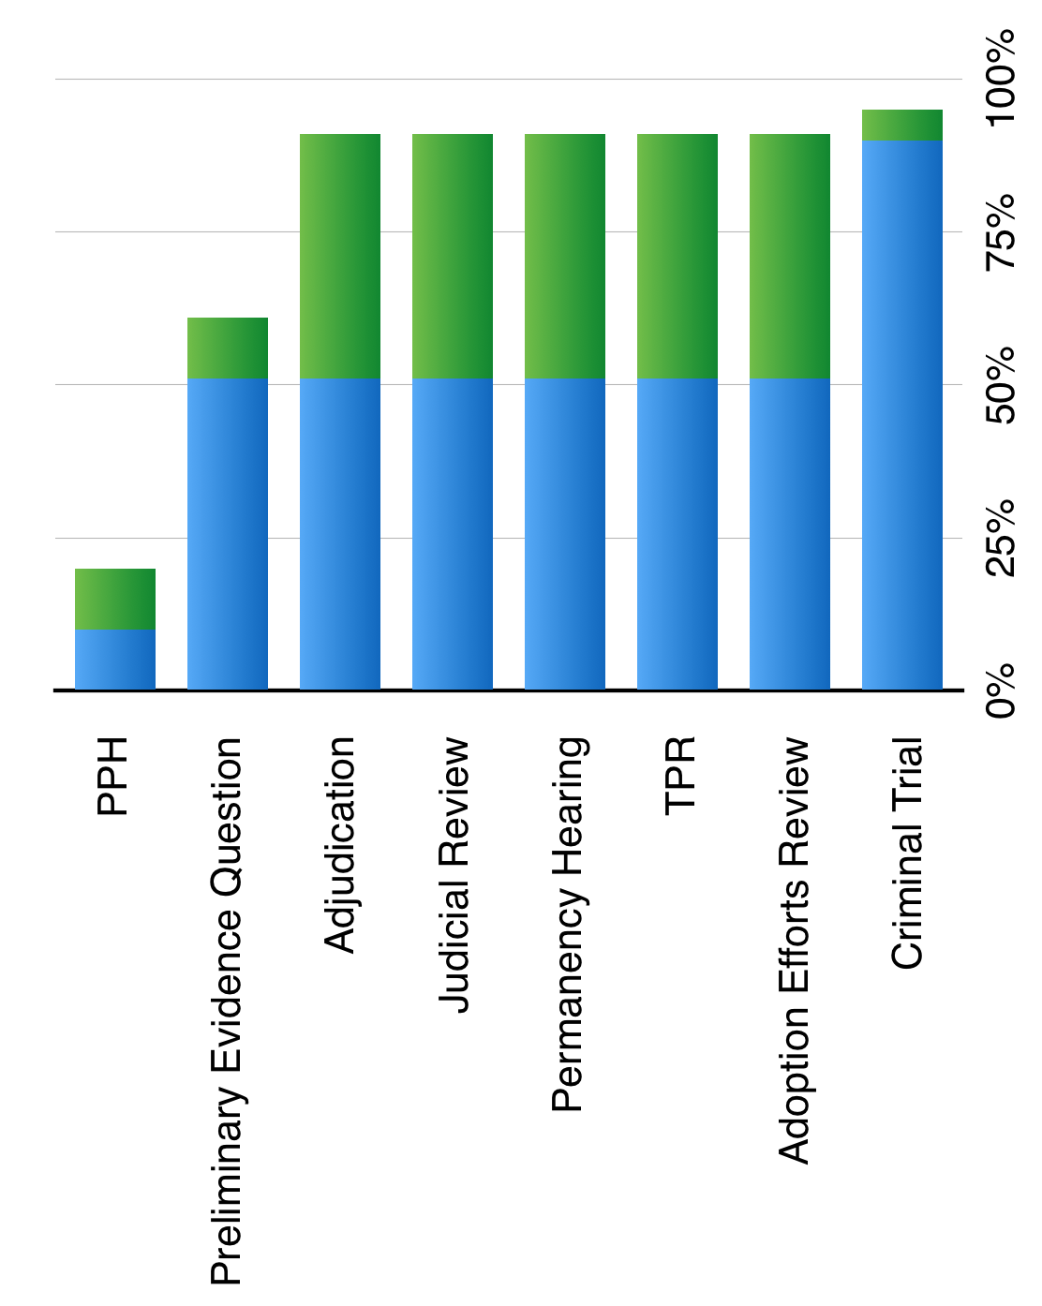

Slide 19
Clear & Convincing =
Substantially more likely than not
Notes:
Beware of the court saying “clear & convincing” but actually meaning “preponderance” - that is, allowing the state to prove its case by simply tipping the scale, rather than by providing showing that its theory is substantially more likely than not.

Slide 20
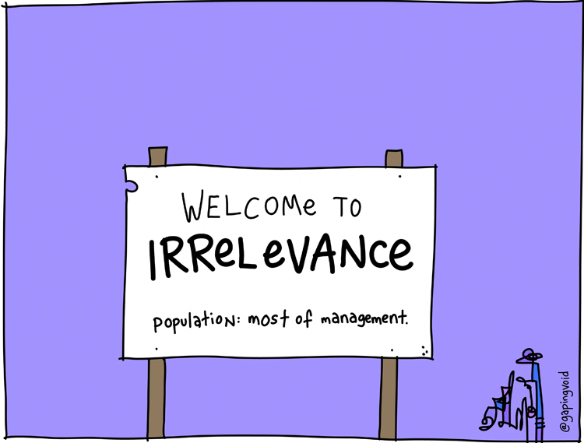
Relevance

Slide 21
“[R]elevant evidence” means evidence having any tendency to make the existence of any fact that is of consequence to the determination of the action more probable or less probable than it would be without the evidence. ~Rule 401
Evidence which is not relevant is not admissible. ~Rule 402
Notes:
ITIO E.M.D., 339 Ga. App. 189 (2016):
Mom repeatedly tested positive for Suboxone (used in MAT).
Mom’s doctor testified that Mom was using the drug under her prescription and that it would not interfere with Mom’s parenting.
DFCS called a testing coordinator from the county Drug Court Treatment Center. Not qualified as an expert on Suboxone.
The coordinator testified that Suboxone produces a high like other opioids, is subject to abuse, makes it difficult for a person to think clearly, and produces severe withdrawal symptoms. She stated that because of this, use of Suboxone disqualifies a person from Drug Court participation.
Mom’s atty objected that the coordinator was not qualified as an expert on Suboxone.
Court held that the testimony was admissible because it was simply about the Drug Court policies.
The court in TPR order found re: Suboxone according to the coordinator’s testimony.
Relevance:
-if witness wasn’t an expert, then her opinion is irrelevant;
-if witness was merely testifying as to the Drug Court policy, then her testimony is also irrelevant.

Slide 22
Experts

Slide 23
RULE 702(b), PART 1:
“If scientific, technical, or other specialized knowledge will assist the trier of fact to understand the evidence or to determine a fact in issue, a witness qualified as an expert by knowledge, skill, training, or education may testify thereto in the form of an opinion or otherwise …”
Notes:
This is just the old standard: specialized knowledge beyond the ken of the ordinary fact-finder.
Not a high bar.

Slide 24
RULE 702(b), PART 2:
“…if:
(1) The testimony is based upon sufficient facts or data;
(2) The testimony is the product of reliable principles and methods; and
(3) The witness has applied the principles and methods reliably to the facts of the case…”
Notes:
This is Daubert (509 US 579, 1993): admit only valid and reliable scientific evidence that fits the case.
And Kumho Tire (526 US 137, 1999): Daubert std applies to all expert testimony, not just “scientific” - in civil cases.

Slide 25
Sufficient Basis
This is simply a requirement that the testimony is based upon sufficient facts or data.
If not, it’s merely speculation.

Slide 26
Reliable Principles
Can the theory/procedure/technique be tested? Has it been tested? How?
Peer review and publication?
Error rates?
Degree of acceptance in scientific community?
Developed for litigation, or independently?

Slide 27
Proper Application
The witness has done everything correctly to ensure an accurate outcome;
AND
The witness has applied the outcomes reliably to the facts of the case.

Slide 28
Not all testimony by an expert is “expert testimony” under the definition of Rule 702(b):
ITIO T.Z.L., 325 Ga. App. 84 (2013)
ITIO J.C., 334 Ga. App. 526 (2015)
Notes:
TZL:
Based on testimony of father’s therapist, ct used “medically verifiable deficiency” grounds to TPR - concluding that a prior head injury rendered the father incapable of caring for the child.
But therapist “merely relayed that the father had mentioned during their interview that, years earlier, he had been in a serious automobile accident”. No one testified or provided any evidence that amounted to a competent opinion as to the father’s mental health or how a deficiency therein affected his ability to care for the child.
JC: psychologist related numerous diagnoses and concerns regarding mom, but never said how mom’s conduct affected child, nor how the child would be harmed by this conduct (including mom’s recent drug use).

Slide 29
Discounting Expert Testimony
Triers of fact may not arbitrarily ignore expert opinion, but may choose not to adhere to it when there is good cause to discount it.
What constitutes good cause?

Slide 30
Discounting Expert Testimony
1. The correctness or adequacy of the factual assumptions on which the opinion is based;
2. Possible bias in the expert’s appraisal;
3. Inconsistencies in the expert’s testimony or material variations between experts; and
4. The relevance and strength of contrary lay testimony.

Slide 31
Privilege
&
Confidentiality

Slide 32
Privileges
Privileged communications may not be testified to, even under court order or other compulsion (Rule 501).
Common examples:
Attorney-Client
Husband-Wife
Confessor-Penitent or Pastoral Counseling
Psychiatrist/Psychologist/LCSW/Other MH Therapist-Patient [But see OCGA §15-11-181(d)]

Slide 33
Confidentiality
Confidential communications must be testified to under legal compulsion (e.g., subpoena).
Doctor-Patient communications (not MH-related) are confidential, but not privileged.

Slide 34
Confidentiality
Confidentiality protections do not generally apply anywhere within the context of legal proceedings. A witness on the stand or a party in discovery may not usually prevent the release of confidential communications or information.

Slide 35
Court-Ordered Evals
No privilege regarding court-ordered MH evals, as long as mental health treatment by that provider is not given or contemplated. State v. Herendeen, 279 Ga. 323, 236 (2005).

Slide 36
HIPAA
HIPAA does not apply to any court-ordered discovery or testimony, as long as the party seeking the testimony provides a written assurance that the party has used reasonable efforts to notify the person whose protected information is sought.
A written assurance of notice must be received by the holder of the protected information before the holder can be compelled to testify.
45 CFR §164.512(e)

Slide 37
HIPAA
45 CFR 164.512(e):
(iii) For the purposes of paragraph (e)(1)(ii)(A) of this section, a covered entity receives satisfactory assurances from a party seeking protected health information if the covered entity receives from such party a written statement and accompanying documentation demonstrating that:
(A) The party requesting such information has made a good faith attempt to provide written notice to the individual (or, if the individual's location is unknown, to mail a notice to the individual's last known address);
(B) The notice included sufficient information about the litigation or proceeding in which the protected health information is requested to permit the individual to raise an objection to the court or administrative tribunal; and
(C) The time for the individual to raise objections to the court or administrative tribunal has elapsed, and:
(1) No objections were filed; or
(2) All objections filed by the individual have been resolved by the court or the administrative tribunal and the disclosures being sought are consistent with such resolution.
Notes:
Usually, it’s going to be a party whose protected health info is sought, and a party will have the opportunity to object, so advance notice may not really be required, since its whole purpose is to provide notice and opportunity to object.

Slide 39
Jerry Bruce
jerry.bruce@georgiacourts.gov

