Slide 2
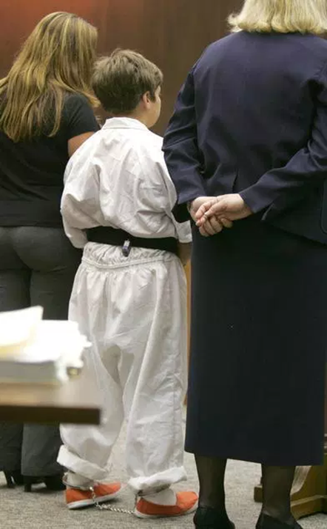
Prior to 2015: Children Routinely Restrained in Juvenile Court
Most states had no policy on juvenile restraints
Children routinely appeared in shackles, regardless of age, size, risk to the court
Restraints typically include metal handcuffs, ankle cuffs and belly chains
“It is particularly traumatic and troubling seeing children who are so small that the cuffs slip off their wrists.” GA Juvenile Court Judge

Slide 3
Shackling Adults Is Inherently Prejudicial
Deck v. Missouri, 544 U.S. 622 (2005)
Violates the constitutional right to due process
Undermines right to a fair trial and presumption of innocence
Is only permissible “in the presence of a special need”
Hill v. Georgia, GA Supreme Court (May 4, 2020)
Murder conviction reversed because court “abused its discretion for failing to make the required case-specific and individualized findings” for shackling of defendant
Notes:
https://njdc.info/wp-content/uploads/2014/09/CAIJS-Model-Statutes-Court-Rules-May-15.pdf
“[Courts have] settled virtually without exception on a basic rule embodying
notions of fundamental fairness: trial courts may not shackle defendants routinely,
but only if there is a particular reason to do so.”

Slide 4
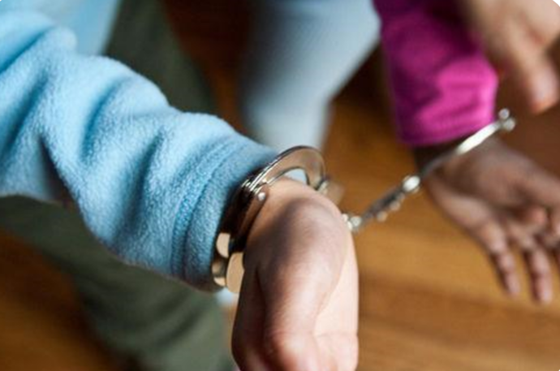
Routine Shackling of Juveniles
Runs counter to rehabilitative purpose of juvenile court
Interferes with due process & right to engage with counsel (OCGA 15-11-1)
Inflicts trauma and damages child’s self-perception
Is unnecessary to protect courtroom security
Notes:
https://njdc.info/wp-content/uploads/2014/09/CAIJS-Model-Statutes-Court-Rules-May-15.pdf
“[Courts have] settled virtually without exception on a basic rule embodying
notions of fundamental fairness: trial courts may not shackle defendants routinely,
but only if there is a particular reason to do so.”

Slide 5
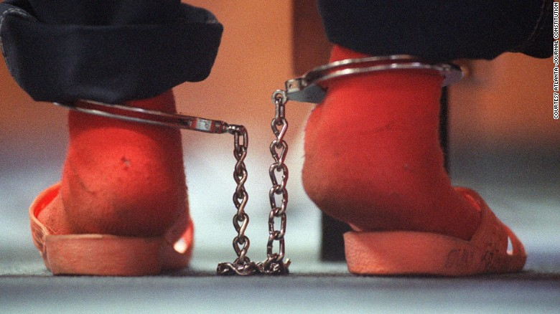
National Council of Juvenile & Family Court Judges (2015)
The NCJFCJ supports the advancement of a trauma-informed and developmentally appropriate approach to juvenile justice that limits the use of shackles in court.
The NCJFCJ supports a presumptive rule or policy against shackling children; requests for exceptions should be made to the court on an individualized basis and must include a cogent rationale, including the demonstrated safety risk the child poses to him or herself or others.
The NCJFCJ believes judges should have the ultimate authority to determine whether or not a child needs to be shackled in the courtroom.
See also, American Bar Association (Res 107A, 2015), Association of Prosecuting Attorneys (2015), National Association of Counsel of Children (2015), National Juvenile Defender Center (2015), and National Center for Mental Health and Juvenile Justice (2015)
Notes:
The NCJFCJ calls for judges to utilize their leadership position to convene security personnel and other justice system stakeholders to address shackling and to work together to identify ways to ensure the safety of children and other parties.
The NCJFCJ encourages judges and court systems to continually review policies and practices related to shackling children.

Slide 6
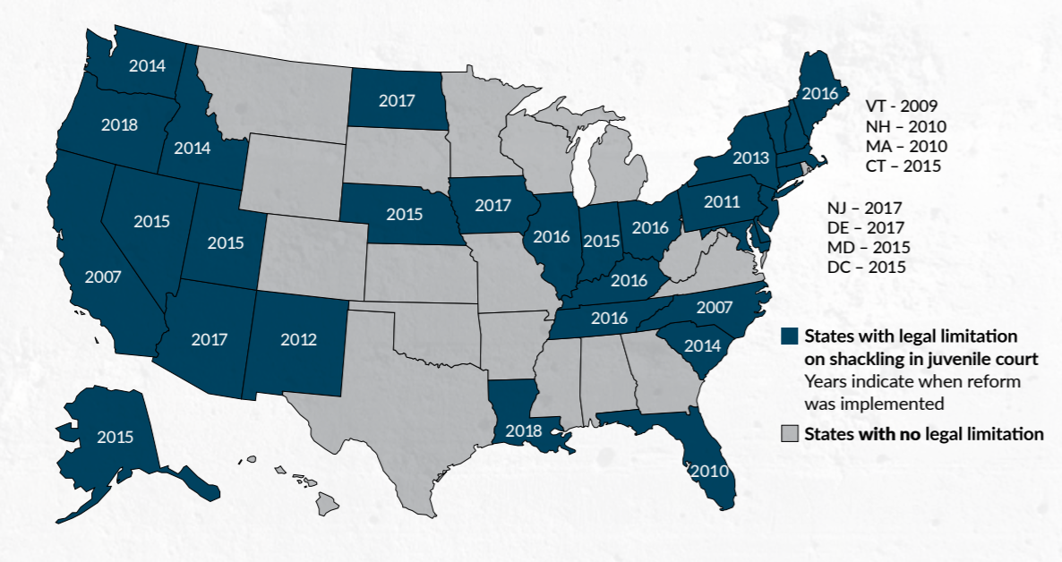
In 2020: 32 States & DC Limit Juvenile Restraints
Notes:
Today, most states in the nation (32 plus D.C.) have abandoned the practice of routinely restraining children in juvenile court. They did this in the face of growing evidence that the practice is unnecessary for courtroom security and harmful to children and their chances of rehabilitation. FL (Rule, 2013),
NC (Statute, 2013),
SC (Statute, 2014; passed unanimously),
TN (Rule, 2016),
KY (Rule, 2016).
Louisiana passed a statute last year.
Fla. R. Juv. P. § 8.100(b) (2013); KY. Juv. R. Prac. & Proc. 23 (2016); N.C. Gen. Stat. § 7B-2402.1 (2013); S.C. Code Ann. § 63-19-1435 (2014); Tenn. R. Juv. P. § 204 (2016), Louisiana Act 453 (effective Aug, 2018)

Slide 7
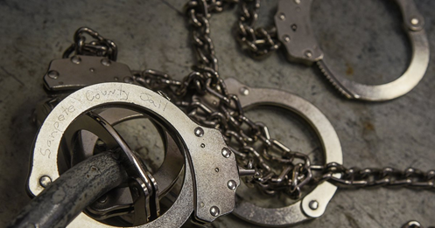
Key Elements of Court Protocols
States have ended routine juvenile shackling by statute,
court rule & administrative order. Key elements include:
a presumption against restraining children in juvenile court
an exception to the rule based on an individualized assessment of the risk of flight or safety concern that the child poses
a finding that there are no less-restrictive alternatives to shackling
*Model Court Rule: https://njdc.info/wp-content/uploads/2014/09/CAIJS-Model-Statutes-Court-Rules-May-15.pdf
Notes:
Only half of the states list factors the court must consider when assessing whether the young person poses a risk.4 Some of these factors are as broad as “any relevant factor,” while others are more specific, with an intent to guide the individualized assessment of each child, including factors like: past attempts to flee, a history of disruptive or aggressive behavior, threats made to self or others, the seriousness of the charge, security resources in the courtroom, and the child’s delinquency history

Slide 8
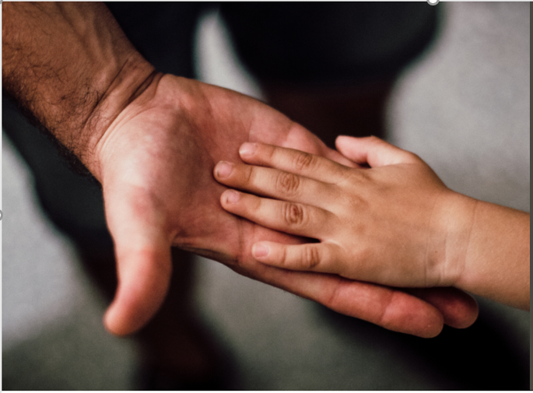
Do Restrictions on Juvenile Restraints Makes Courtrooms Less Safe?
Miami-Dade, FL has had a presumption against shackling for 10+ yrs; 30,000 children have appeared in court without escape or injury.
Travis County, TX held nearly 7,000 juvenile hearings in 2013-2014 without incident
New Orleans Parish, LA held 4,000 juvenile hearings/yr from 2015-18 and reported no problems, even with reduction in security staff.
Chatham, Clayton and Troup County, GA have restrained fewer than 10 children, combined, in the past 5 years without any threats to courtroom security

Slide 9
Routine Use of Restraints Is Still Common in Georgia
*Based on partial survey of court administrators, sheriffs and public defenders in all 10 judicial districts, 2019-2020.
Notes:
In 2017 - 2018, bipartisan legislation introduced to limit indiscriminate shackling of children unless the court issued an order that “the use of restraints is necessary based on review of multiple risk factors.

Slide 10
Judicial Stakeholder Views on Shackling in Georgia
2018 survey of 174 judicial stakeholders across state
Majority of stakeholders wanted state law to restrict juvenile shackling
“According to research the psychological impact is great, and trying to convince a child that they are innocent until presumed guilty while shackled is tough.”
“Adults are not shackled. But juveniles charged with the most minor crimes are shackled. It does not make sense. And it is contrary to the purpose of the juvenile code trying not to treat kids as criminals, but only as making bad choices.”
“Unshackled children are generally more relaxed and better behaved.”

Slide 11
UJCR 20: Physical Restraint of Juveniles in the Courtroom
Consistent with applicable law, a juvenile may not be physically restrained during a court proceeding unless such restraint is authorized by court order or local protocol of the court.
Every juvenile court shall establish a written protocol that addresses the circumstances under which a juvenile may be physically restrained while appearing in court, which considers
the welfare and due process rights of the juvenile,
the integrity of the judicial proceeding, and
the safety of the court and public.
Effective July 1, 2020

Slide 12
Panelists
Judge Michael Key - Troup County Juvenile Court; Lead Judge, J4C Court Improvement Initiative
Dr. Sarah Vinson - Licensed Child and Adolescent Psychiatrist, Lorio Psych Group
Ms. Jennifer DeWeese - Parent Representative, DJJ Youth Reentry Task Force and DeKalb County DJJ Citizen’s Academy

Slide 16
If you're treated a certain kind of way, you become a certain kind of person. If things are described to you as being real, they're real for you whether they're real or not.
- James Baldwin

