Slide 1
Attachment Issues in Abuse and Neglect Cases
an overview

Slide 2
Priscilla Faulkner, Psy.D.
Southeastern Psychological Associates, Inc.

Slide 3
Attachment is a deep and enduring emotional bond that connects one person to another across time and space.(Ainsworth,1973)

Slide 4
Attachment does not have to be reciprocal.

Slide 5
Timing is Everything

Slide 6
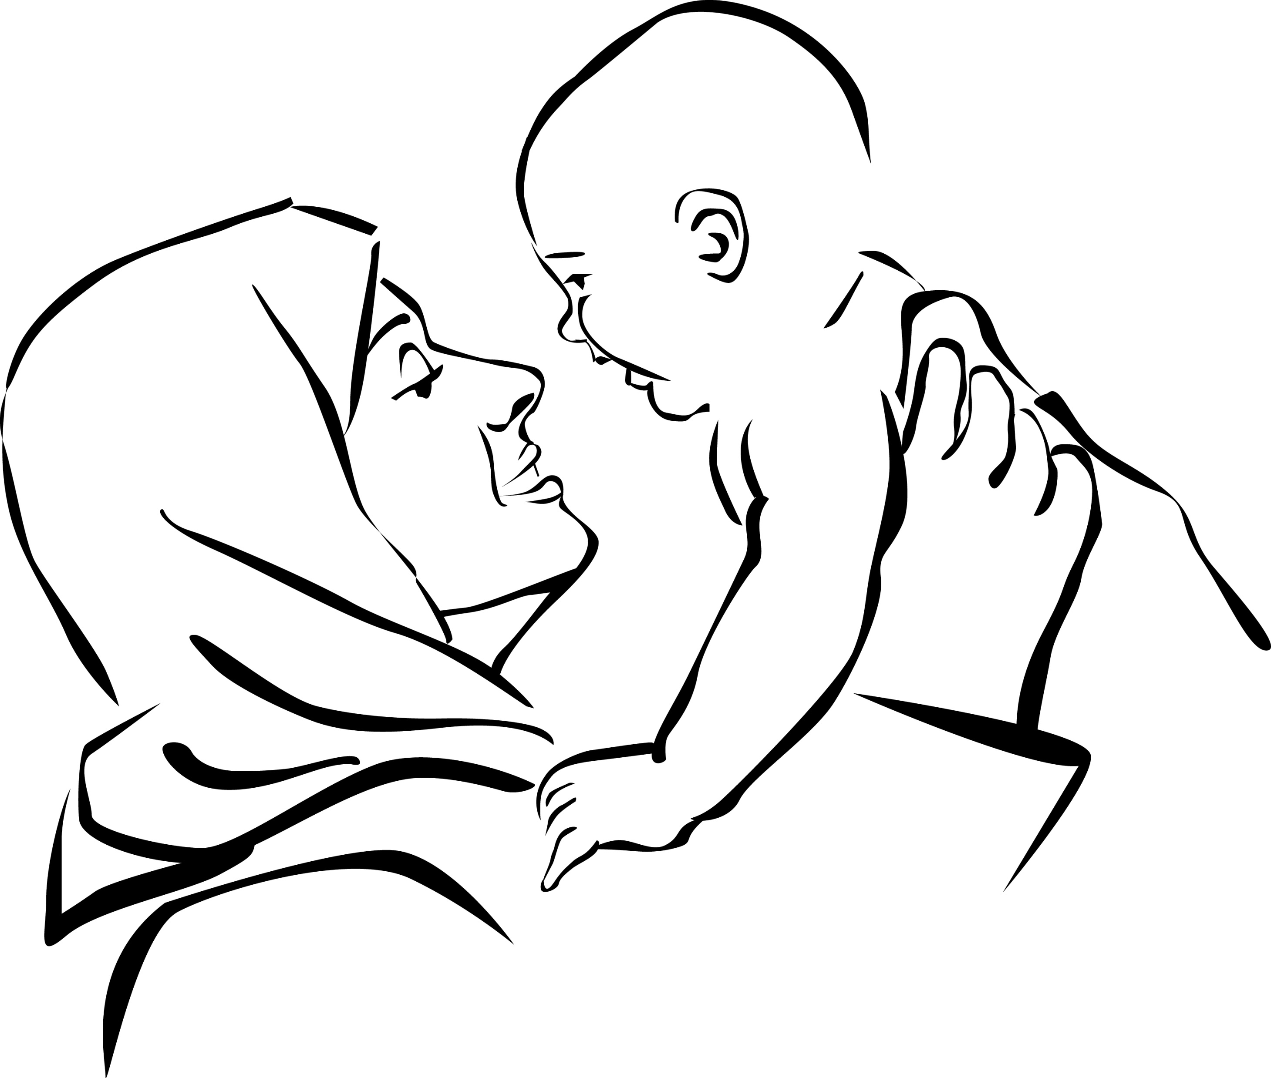
Early bonds are building blocks.

Slide 7
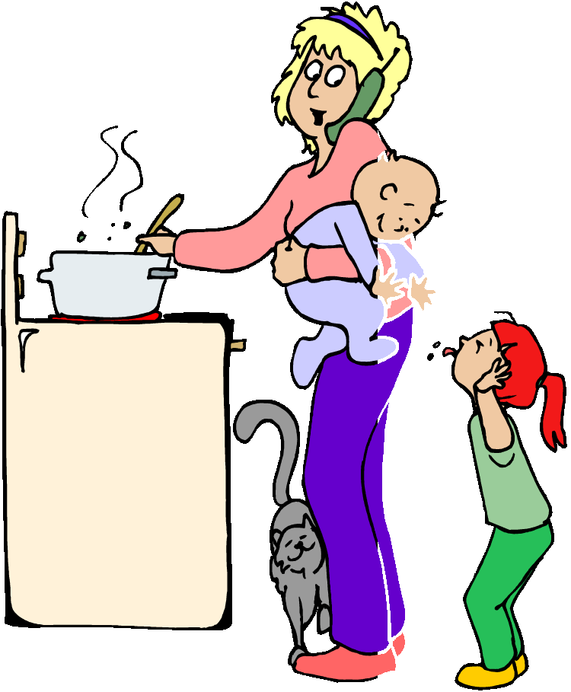
Better is better than more (Sensitive Responsiveness)

Slide 8
Oh No!! Where is my mom????
Stages of Separation Anxiety (John Bowlby)
Protest
Despair
Disengagement

Slide 9
A Two Year Old Goes to the Hospital

Slide 10
Going to the Hospital with Mother

Slide 11
Trauma’s effect on bonding.

Slide 12
Time in Place

Slide 13
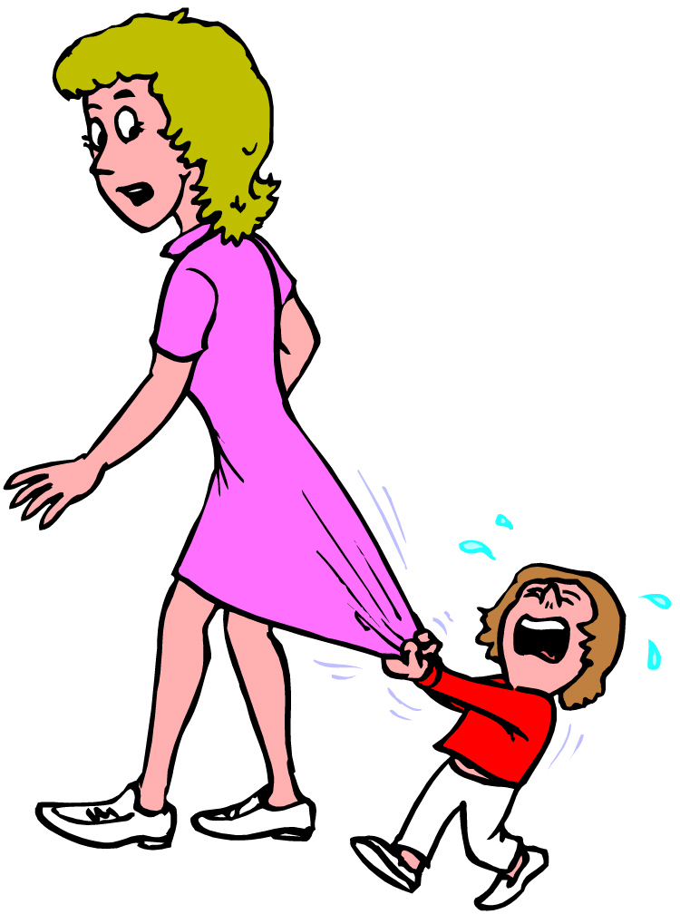
Child behavior and bonding.

Slide 14
Bonding is Reciprocol.

Slide 15
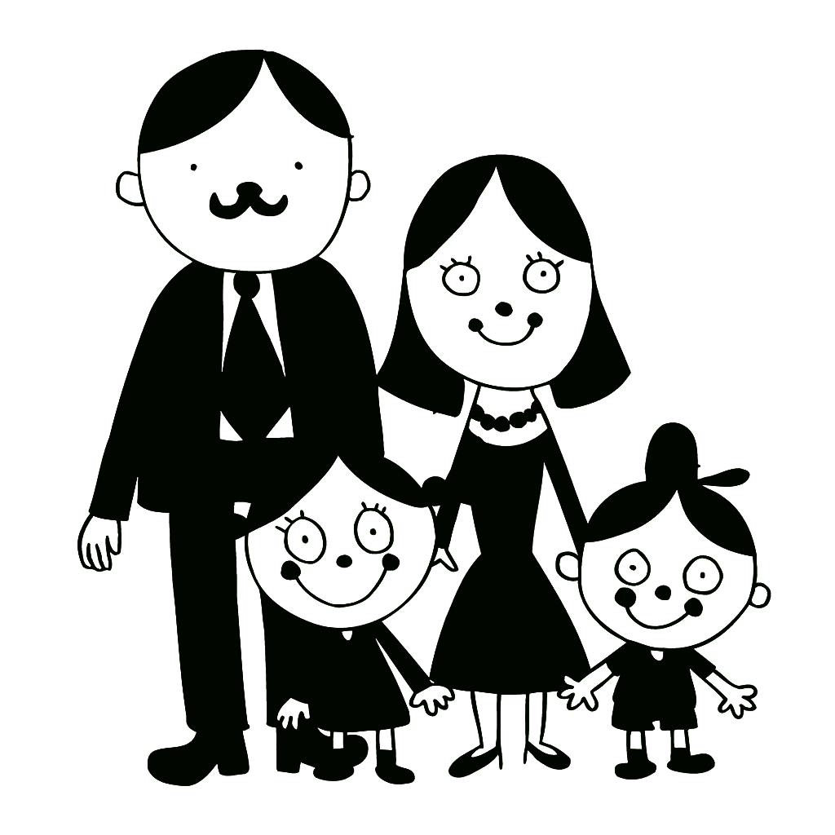
Family Identification

Slide 16
Resiliency

Slide 17
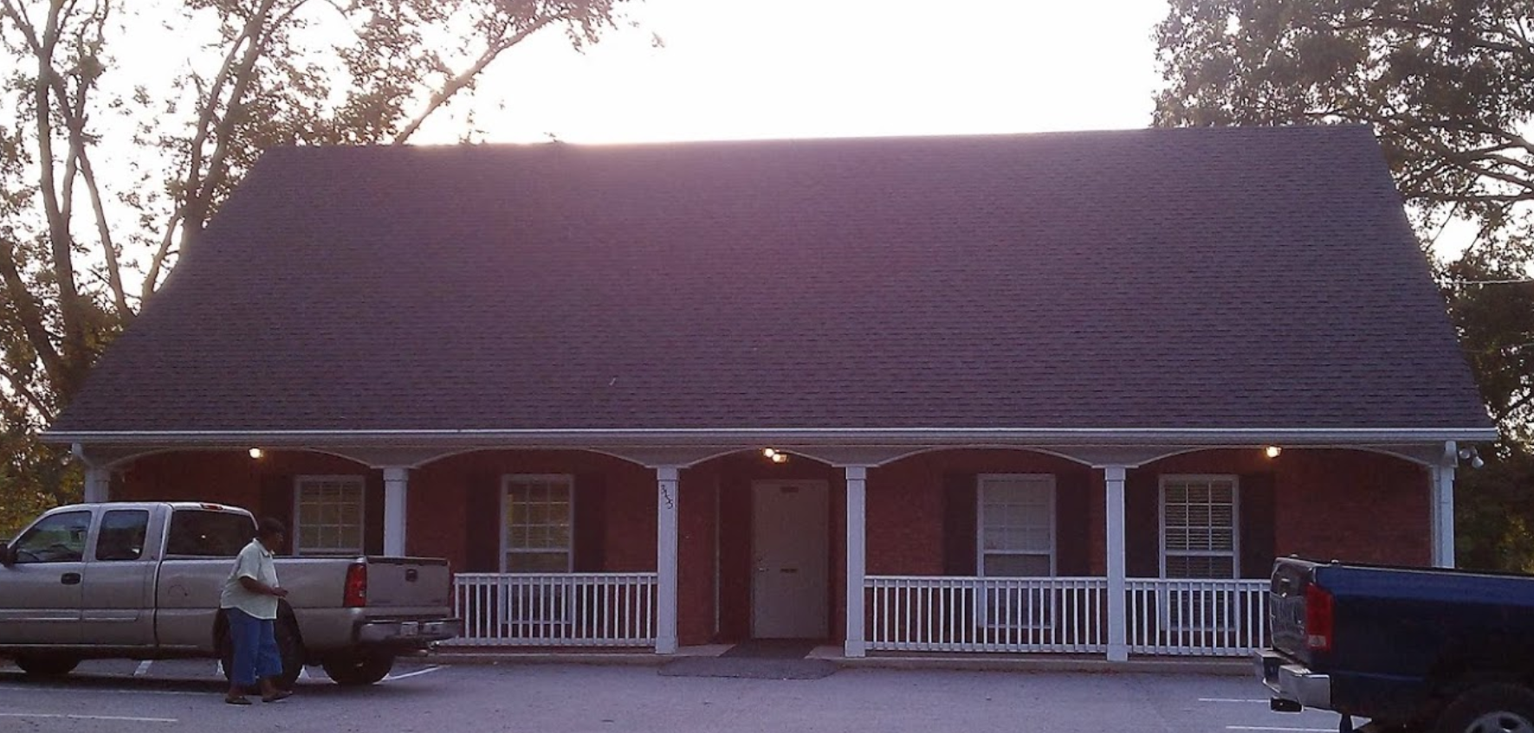
678 712-6520
Pfaulkner@sepsych.com
southeasternpsyc.com

