Slide 1

USING NACC RESOURCES AND YOUR INFLUENCE TO IMPROVE GEORGIA’S CHILD WELFARE LEGAL SYSTEM
Jen Carreras, CWLS
Deputy Director
Georgia Office of the Child Advocate

Slide 2
OFFICE OF THE CHILD ADVOCATE: An overview
We have a whole article of the juvenile code!
The Office of the Child Advocate exists to “provide independent oversight of persons, organization, and agencies responsible for providing services to or caring for children who are victims of child abuse and neglect … The office of the child advocate will provide children with an avenue through which to seek relief when their rights are violated by state officials and agents entrusted with their protection and care.” 15-11-740(b).
Notes:
DFCS 2. Attorney performance
Right to counsel – 15-11-103
The question is what relief can we facilitate or provide?

Slide 3
OCA’s Work
INDEPENDENT OVERSIGHT
ADVOCACY
TRAINING

Slide 4
INDEPENDENT OVERSIGHT
(OMBUDS SERVICES / INVESTIGATIONS)
OCA provides independent oversight of any agency, professional, or individual serving a child who has been touched by DFCS in the last 5 years. O.C.G.A. § 15-11-741(3)
Not limited to DFCS oversight
OCA responds to complaints submitted by any individual. Complaints are usually submitted via webform, but are also submitted via telephone to our general mailbox, or often directly via email or telephone from professionals to OCA leadership
https://oca.georgia.gov/request-oca-assistance-or-investigation

Slide 5
INDEPENDENT OVERSIGHT
(OMBUDS SERVICES / INVESTIGATIONS)
INDIVIDUAL CASE REVIEWS
Constituent complaints
Foster parent grievances
Mediation
SYSTEMIC ISSUE IDENTIFICATION
CAP Model Protocol clearinghouse and training
County audits
Special investigations
Child Death and Serious Injury Collaborative

Slide 6
Rights of the OCA:
To communicate privately with any child
To inspect and copy all DFCS records and all records of the court, law enforcement, medical and mental health providers, agencies, service providers, placements and institutions concerning or relating to a child
To enter and inspect any residence, institution, or other location where a child is currently placed
To pursue formal remedies when informal remedies do not work
To issue subpoenas
To engage in advocacy and education of the public

Slide 7
2022 OCA INVESTIGATIONS SUMMARY
256 individual investigations
27 CDSI reviews
6 special investigations
5 county audits (Bulloch, Glynn, Gwinnett, Fannin, Clarke)
Over 500 children’s SHINES or court records reviewed
Over 500 DFCS staff / stakeholders interviewed
2 unannounced placement visits

Slide 8
Advocacy
QUALITY LEGAL REPRESENTATION
QLR IMPROVEMENT PROGRAM
JCAMP ASSESSMENT TOOL DEVELOPMENT
LEGISLATIVE ADVOCACY
CASE-LEVEL ADVOCACY AND SUPPORT
CASE CONSULTATION
POSITION LETTERS
AMICUS APPELLATE ADVOCACY
CHILD WELFARE-RELATED LEGISLATION
OCA STATUTE

Slide 9
Training
THE SUMMIT
2022 – 6th annual multi-disciplinary conference – over 750 professionals trained
MDCANI
2022 – Over 550 professionals trained at the local level
CHILD ATTORNEY ONLINE TRAINING COURSE
Launched Feb 2023
9 hours of CLE
LOCAL TRAININGS
Legal ethics / Best practices
Safety science
Quarterly training for the Georgia Police Academy (GPA) at the Georgia Public Safety Training Center

Slide 10

TINY BUT MIGHTY…

Slide 11

Programs and Services for the Child Welfare Legal Community

Slide 12
National Association of Counsel for Children
We help lawyers help children, parents, and families.
Promoting Excellence
Building Community
Advancing Justice
TRAINING & CERTIFICATION
NACC offers attorneys high-quality trainings, adaptable education materials, & Child Welfare Law Specialist certification program
PRACTITIONER NETWORK
NACC builds a sense of community by hosting conferences, networking opportunities, & an open forum for discussion
POLICY & ADVOCACY
NACC works to publish legal opinions, write amicus briefs, & advocate for policies aimed at improving child welfare in the US
For more than 45 years, the National Association of Counsel for Children has strived to serve children and families by supporting a community of professionals
dedicated to providing high-quality legal representation.

Slide 13
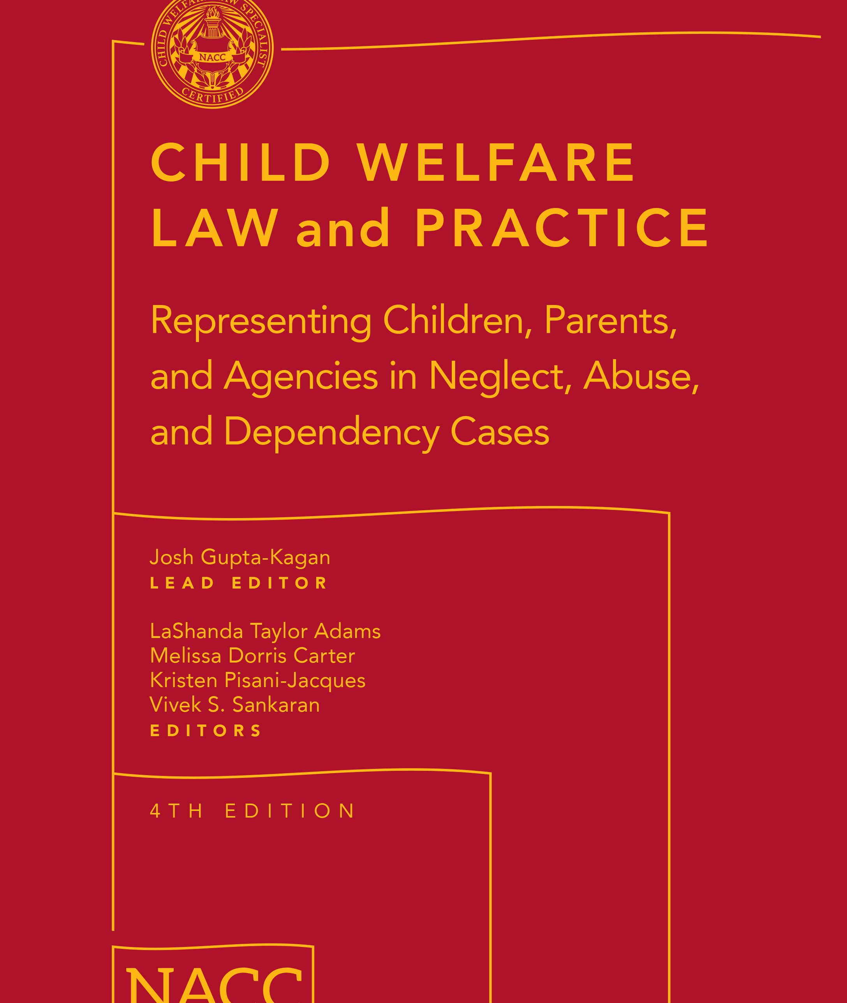

Promoting Excellence:
Training and Certification
  NACC publishes Child Welfare Law and Practice, known as “The Red Book,” new 4th Edition
  NACC provides attorney trainings, including our 7-week online Red Book Training Course
  NACC houses QIC-Child Rep Training and Policy Materials
  NACC is accredited by the American Bar Association to certify attorneys and judges as Child Welfare Law Specialists

Slide 14

Child Welfare Law Specialist certification signifies an attorney’s specialized knowledge, skill, and verified expertise.
NACC only grants the CWLS credential to attorneys who successfully complete a rigorous application and examination process. This professional achievement is the highest testament to an attorney’s dedication and demonstrated excellence in child welfare law.
Child Welfare Law Specialist (CWLS) Certification

Slide 15
For the purpose of CWLS certification, the American Bar Association defines child welfare law as “the practice of law representing children, parents or the government in all child protection proceedings including emergency, temporary custody, adjudication, disposition, foster care, permanency planning, termination, guardianship, and adoption. Child Welfare Law does not include representation in private custody and adoption disputes where the state is not a party.”
Child Welfare Law Specialist (CWLS) Certification

Slide 16
The Children’s Bureau strongly encourages all attorneys and judges practicing child welfare law to obtain CWLS certification.
The Children’s Bureau, in its 2017 Informational Memorandum on the importance of high-quality legal representation for all parties in child welfare cases.
Child Welfare Law Specialist (CWLS) Certification

Slide 17
Application Process
Check Eligibility and Application Requirements
Review Certification Standards
Submit Your Application Online
Prepare for the Exam
Take the Exam
Eligibility and Application Requirements (GA)
3 or more years practicing law
30% or more of the last three years involved in the field of child welfare law (30% of last 5 years in SC)
A resume/CV detailing your involvement in the field
36 hours of continuing legal education within the last three years in courses relevant to child welfare law (45 hours in CA; 36 hours of state-approved CLE in OH and SC)
A writing sample drafted within the last three years that demonstrates legal analysis in the field
Your public and private disciplinary history
Peer review responses
Application Fees
NACC Members $375
Non-members $500
Child Welfare Law Specialist (CWLS) Certification

Slide 18
Building Community:
Membership & Conference
Joint GACC-NACC Membership
State Coordinator Network
Children’s Law Office Project
National Child Welfare Law Conference

Slide 19
Member Resources
National Listserv
Monthly Member Webinars
Monthly Newsletter The Advocate
Quarterly Law Journal The Guardian
Conference Materials Library
Discount on The Imprint and Clearbrief
Discounts: Red Book, Training, CWLS, Conference
Higher Level Memberships include the Red Book
Individual Memberships
Organizational Memberships
Student Memberships

Slide 20

Advancing Justice:
Policy Advocacy
  NACC Policy Agenda (update pending)
  NACC Recommendations for Legal Representation of Children and Youth
  Amicus Curiae program
  Counsel for Kids Campaign
  Title IV-E Funding for Legal Representation
  Family First and Prevention Services Act
  Engaging Lived Experience Experts
CounselForKids.org

Slide 21
NACC’s Recommendations for Legal Representation of Children and Youth in Neglect and Abuse Proceedings
Notes:
Most of the following slides were provided by Allison Green, Legal Director for NACC
Best practices, though many of them mirror our duties as attorneys under the Georgia Rules of Professional Conduct

Slide 22
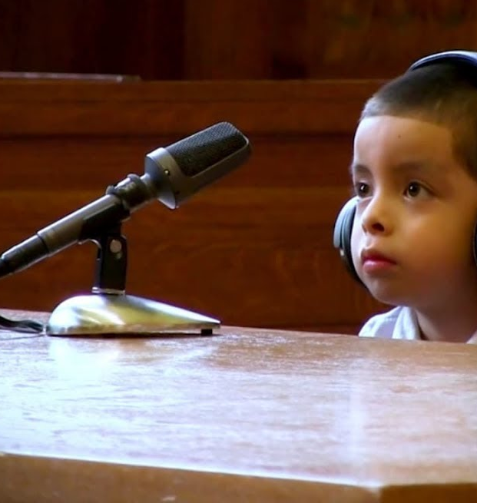
The Realities
State intervention is often a traumatic experience.
Children experience harm while in foster care.
The court process can be a lifeline for children, but many are forced to navigate it alone.
Notes:
State intervention, even when necessary, is a traumatic experience for children and families
Family separation: grief, loss, attachment
Loss of everything familiar (family, friends, neighborhoods, school, belongings, churches, community groups, etc.)
Extreme uncertainty
Children and youth experience harm while in foster care
Abuse and neglect in foster care
Foster care placement instability
Physical and sexual health problems
Mental health consequences
Poor long-term outcomes
Disconnection (sometimes permanent) with familiar, cultural, social ties/connections

Slide 23
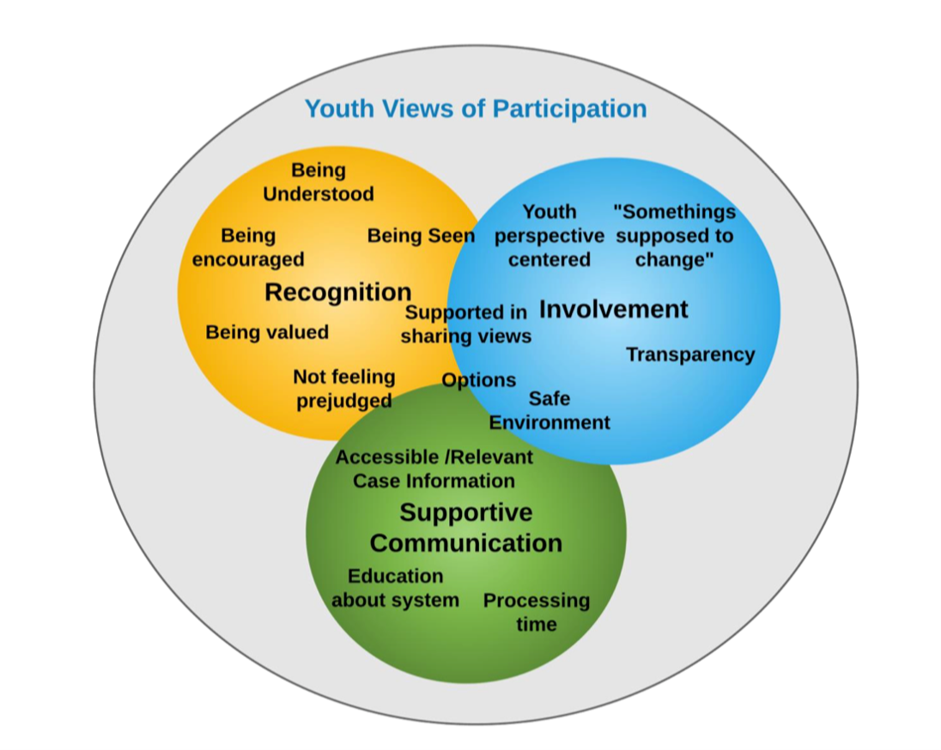
Youth Should Be Seen & Heard
Persons with lived experience in the child welfare system overwhelmingly indicate a desire to:
Be heard;
Be engaged in their legal proceedings;
Be told what is happening in their case.
Cody, Anna. “Children’s Participation Rights in Child Welfare Systems: Identifying Opportunities for Implementation.” https://scholarscompass.vcu.edu/cgi/viewcontent.cgi?article=7617&context=etd

Slide 24
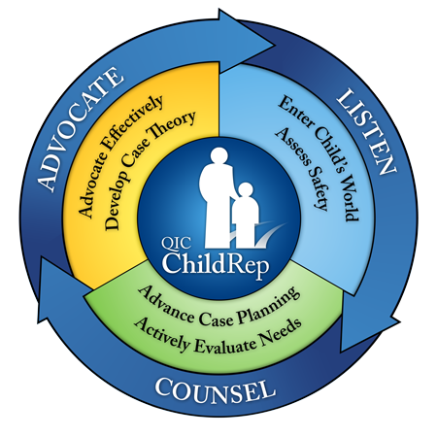
A Growing Body of Research
Research in Florida's Palm Beach County showed that children represented by standards-based counsel exited to permanency at rates up 1.39 times higher than comparison children, primarily due to higher rates of adoption and long-term custody
A 6-year federal study found that children represented by specially trained counsel were 40% more likely to exit foster care within first 6 months.
In Washington State, legal representation increased reunification & guardianship rates by 41%.
Notes:
Preliminary finding from the Dependent Children Legal Representation Study conducted by the Washington State Center for Court Research show that Children with mandatory legal representation were more likely to experience reunification or guardianship than to become legally free or adopted. Specifically, the reunification or guardianship rate of children with mandatory representation is about 41% higher than the rate of reunification or guardianship for children without mandatory representation (i.e. business as usual).
A 6-year, federally funded National Quality Improvement Center on the Representation of Children in the Child Welfare System (QIC-ChildRep) study, found that children represented by specially trained legal counsel were 40% more likely to exit foster care within their first six months
Another study conducted by Chapin Hall at the University of Chicago determined that children assigned lawyers exited foster care at significantly faster rates and with more individualized case plans than children who did not have lawyers.

Slide 25
A Growing Body of Research
DECREASES IN:
Family separation
Placement changes
Repeat maltreatment
Re-entry to foster care
School changes
Agency costs
INCREASES IN:
Kinship placements
Permanency timeliness
Youth/family engagement in case planning, services and court hearings
Youth/family mental and physical well-being
Engagement in extracurricular/ "normalcy" activities

Slide 26
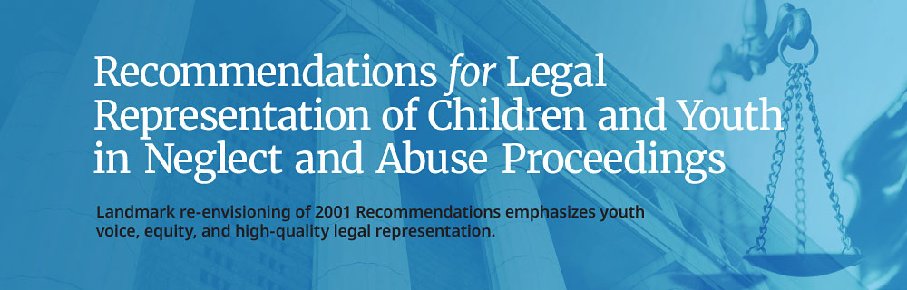
Establish an Attorney-Client Relationship: Attorneys for children and youth should adhere to an expressed interest model of legal representation
Support the Attorney-Client Relationship: Attorneys for children and youth should maintain frequent contact and intentional communication, tailored to the client’s individual circumstances
Offer Legal Counsel and Advice: Attorneys for children and youth have an ongoing, affirmative duty to advise clients of their rights, educate them about the legal process, inform them of their options, and counsel their decision-making
Notes:
Dual role provides a practical and cost-saving alternative, but the legal rep guidelines establish that it is not best practice
Listen and let the client guide the discussion – communicate between hearings
Duty to advise, per GRPC, includes informing client of unpalatable information when that information may affect the client’s position
Are you waiving your client’s presence without consulting your client? That is the client’s decision, not yours.
Stay current on the law and use the law to your client’s advantage in a timely manner

Slide 27
Ensure Opportunity for Full Participation: Attorneys for children and youth should proactively ensure opportunity for meaningful participation in court hearings and other case events
Provide Competent Legal Representation: Attorneys for children and youth should provide competent legal representation
Provide Loyal and Independent Legal Representation: Attorneys for children and youth should guarantee loyalty and independence throughout their legal representation
Notes:
Dual role provides a practical and cost-saving alternative, but the legal rep guidelines establish that it is not best practice
Listen and let the client guide the discussion – communicate between hearings
Duty to advise, per GRPC, includes informing client of unpalatable information when that information may affect the client’s position
Are you waiving your client’s presence without consulting your client? That is the client’s decision, not yours.
Stay current on the law and use the law to your client’s advantage in a timely manner

Slide 28
Maintain Confidentiality: Attorneys for children and youth should adhere to the same confidentiality and privilege rules as they do for adult clients
Advance Equity in Legal Representation: Attorneys for children and youth should engage in culturally humble representation and actively challenge inequitable treatment
Provide “360°” Advocacy: Attorneys for children and youth should seek to understand their clients as whole people, inside and outside the context of the legal proceedings, and provide holistic advocacy
Preserve Continuity of Legal Representation: Attorneys for children and youth should endeavor to provide uninterrupted legal representation
Notes:
6. Loyalty under the GRPC - Free of any conflicts of interest or potential conflicts of interest, including your own opinion of what is best for the child or the client
7. Can’t disclose information related to the representation without express consent of the client
8. Identify your biases and prevent them from interfering with your representation. Seek objective information if necessary
9. Multidisciplinary representation – see the assistance of subject matter experts
10. Establishing and maintaining trust and rapport

Slide 29
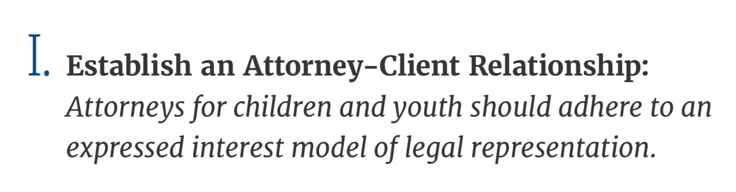
The “What”… | …and the “How”
Meaningful and effective engagement Autonomy Cultural humility | Client-directed model of legal representation Substituted judgement for model for infants (Rule 1.14) Emphasis on collateral contacts and family integrity
Notes:
While meaningful and effective engagement of child clients can occur across different models of legal representation, client-directed representation, however, provides the greatest assurance of maximizing youth voice, autonomy, and mini- mizing attorney bias that often exacerbates racial and ethnic disparities in the child welfare system.
PWLE have expressed the importance of being heard and being given the opportunity to make decisions of their own life.
“I knew that I could establish a positive relationship with my social workers and attorneys
because they gave me autonomy and opportunities to make decisions and be
involved in my case.”

Slide 30
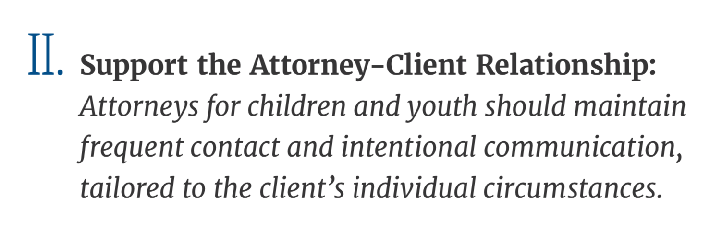
The “What”… | …and the “How”
Understanding the attorney's role Follow-up and follow through building rapport Strengths-based Multidisciplinary approach | Early appointment Frequent client engagement (monthly) Time and place tailored to client need/ comfort level Use of multidisciplinary models
Notes:
The "What"
More often than attorneys might think, youth don't always have a clear understanding of what the role of their attorney is; there are so many people on a youth's case, it's important for an attorney to clearly explain what their role is vs the other professionals in the youth's realm
Language and checking in for understanding: an AC member shared“I think it would have been helpful to make [attorney’s] language more youth friendly and not use so much jargon. I felt stupid for not always understanding what they were saying.”
Part of this is explaining communication expectations and ensuring attorneys follow up and follow through
Attorneys must build rapport with their client by meeting them where they are at and ensuring that they remember they are humans, they are young people
Attorneys should use a strengths-based approach and celebrate their clients wins-big or small
Multidisciplinary representation is a great approach, when one person can't fill a need, another person can. This can make it easier for the youth to feel supported

Slide 31


Client Contact is Key!

Slide 32
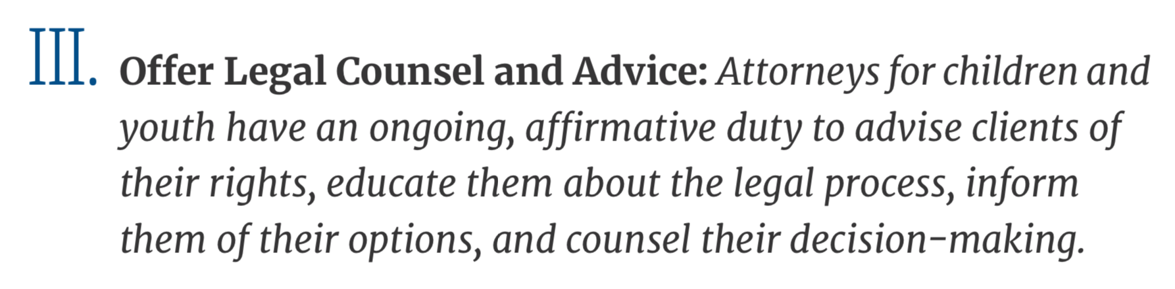
The “What”… | …and the “How”
Helping a client understand their rights Preparing the youth Removing bias | Out-of-court counseling role just as important as in-court activity (Rule 2.1) Avoiding use of legal terms Trauma-informed candor Checking for understanding
Notes:
Allison
Youth need to know their rights, including not limited to: their right to safety, their custody status, an attorney should go through the foster care bill of rights, and all of their permanency options An AC member stated“It would have been helpful if my rights as a child were explained to me...I did not believe that I had any say in what happened to me, which was not true.”
Youth should be prepared for all meetings and court hearings involving their case, youth should know very well what is going to happen next
In order to be fully transparent and talk through all options with their client, attorneys should work to remove their biases as to not place their own values and beliefs one the youth they are working with

Slide 33
Client Counseling
Explain and ensure understanding
Court processes
Hearings/trials
Potential/likely outcomes
Court orders
Client questions
Advise and counsel
Court preparation
Legal and trial strategy
Impact of client’s actions
“It would have been helpful if my rights as a child were explained to me...I did not believe that I had any say in what happened
to me, which was not true.”
NACC ADVISORY COUNCIL MEMBER

Slide 34
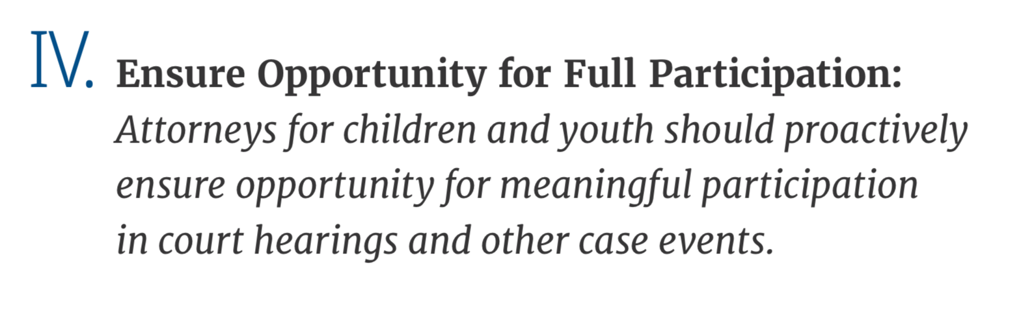
The “What”… | …and the “How”
Encourage involvement and remove assumption Autonomy Preparing the youth Avoid depersonalizing terms | Involving youth in all possible choice points (Ex. court scheduling, seating) Legal rigor if another party asks for the youth to be excluded over the youth’s objection Pre-briefs, debriefs, and ADR
Notes:
Cristal
Youth should be encouraged to attend court and to be involved in their case. Attorneys shouldn't assume youth aren't interested or need to be shielded from being a part of the decisions being made about their life. Our AC members have shared that missing school or other priorities have been seen as not wanting to be involved in their case, instead of their wants and needs being considered.
Attorneys should be intentional about providing opportunities for youth to make their own decisions and have autonomy over their being. An AC member shared: “My attorney would ask me where I’d like to sit in court. In a system where you have very little power or choices, I should at least be able to choose where I sit.” Youth have shared that a lot of decisions get taken away from them when being involved in the CW system, making decisions is a skill and youth in foster care deserve the chance to strengthen that skill
Youth should be prepared to participate fully in court, they should be aware of the options they have to participate – not all youth feel comfortable speaking in what can be a large room full of adults so knowing they can have a say without talking aloud can be helpful
. Attorneys should avoid using depersonalizing terms, the youth and families that attorneys are working with are people who deserve to be regarded as such

Slide 35

“An attorney told me when I wasn’t attending court as regularly because of volleyball ‘I haven’t seen you in a while, I thought you didn’t care,’ and of course I cared, it’s my life. But I had things going like volleyball and I didn’t want to miss practice which would lead to missing games.” -NACC ADVISORY COUNCIL MEMBER
“My attorney would ask me where I’d like to sit in court. In a system where you have very little power or choices, I should at least be able to choose where I sit.” -NACC ADVISORY COUNCIL MEMBER

Slide 36
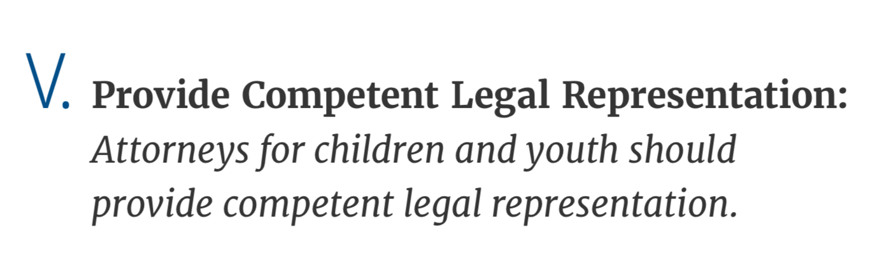
The “What”… | …and the “How”
Competent representation (Rule 1.1) Ongoing training Cultural humility | Expanded list of required training topics (Ex. trafficking) Recommended range of 40-60 individual clients Oversight and accountability structures for attorney representation
Notes:
Allison
Attorneys should provide their clients with competent representation
Part of providing competent representation is having the time to do so and participating in ongoing training in the following areas:
Sources of law, which include case law and court rules
Legal training, which include family law, the Indian Child Welfare Act, and Immigration
Cultural humility, which includes cultural identity concepts and practices and white supremacy and racism
Social science, which includes child development and attachment, mental health, and trauma
Skills, which include client interviewing, trauma-informed practices, and case planning

Slide 37

Knowledge of:
Dependency Law
Federal and state:
Statute
Administrative code/regulations
Case law
Court rules
Agency policies

Slide 38
Knowledge of:
Collateral Areas of Law
Delinquency
Public benefits
housing
Criminal
Domestic relations/ Family law
Education/ special education
Domestic/ interpersonal violence
Appellate

Slide 39

Knowledge of:
Social Science/Research
Trauma
Child/adolescent development
Mental health
Substance abuse
Quality family time
Services/needs
Culturally humble practice
Secondary traumatic stress
Systemic issues

Slide 40

Knowledge of:
Ethics
Models of representation
Best interest
Stated interest
Hybrid
Substituted judgment
Diminished capacity
Duties to others
Candor
Fairness
Conflicts
Siblings
Former clients
Other family members
Best v. expressed interests
Duties to client
Competence
Zeal
Diligence
Confidentiality

Slide 41
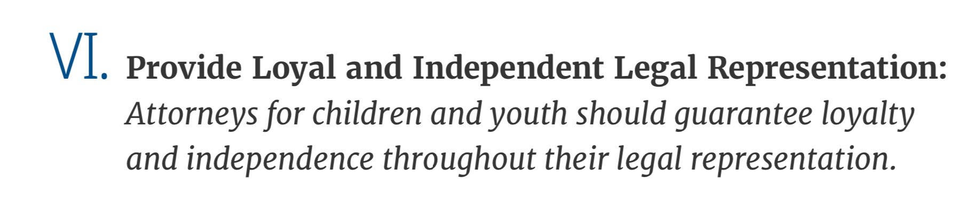
The “What”… | …and the “How”
Champions Sibling relationships Comprehensive investigation | Zealous advocacy for the client’s position Grappling with potential conflicts of interest (Rule 1.7) Robust investigation, including of cultural identity
Notes:
Attorneys should be champions of their client, “Mak[e] them feel like they’re somebody and worth the fight.” Attorneys should respect their client, consistently using a strengths-based approach when discussing their client and talking with them
Sibling relationships may be tricky sometimes and PWLE have shared the complexities that brings to families sometimes. Discussions should be had separately and should have all sides explored
Young people who have navigated the foster care system have shared that often their identities are taken into consideration, attorneys should be intentional about getting to know their client fully and gathering information that will help them advocate for their client. Comprehensive investigation involves exploring the client's cultural identity- this includes but is not limited to: foods they like, the music they are interested in, the way they dress, their religious practices, family traditions.

Slide 42

Out-of-Court Advocacy/Skills
Independent Investigation
People
Places
Things
Safety, Well-Being, and Permanency

Slide 43
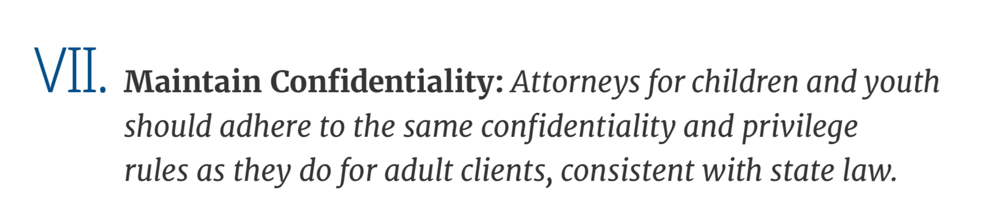
The “What”… | …and the “How”
Safe space Establishing trust Mental health & confidentiality | Affirmed importance of confidentiality – including as a safety measure. (Rule 1.6) Confidentiality around mental health privileges
Notes:
Allison
Confidentiality is the hallmark to an attorney-client relationship, this should be discussed with the client at the beginning of the relationship and throughout their case
There are many people in the youth's life that are mandatory reporters, the youth should feel that they are in a safe space when interacting with their attorney.
Attorneys need to be mindful that it may take time to establish trust with their client, building rapport and establishing a relationship can help with this
Mental health services are super important for youth who have endured trauma (and anyone really), confidentiality must be protected here so that the work they do towards healing isn't impeded on

Slide 44
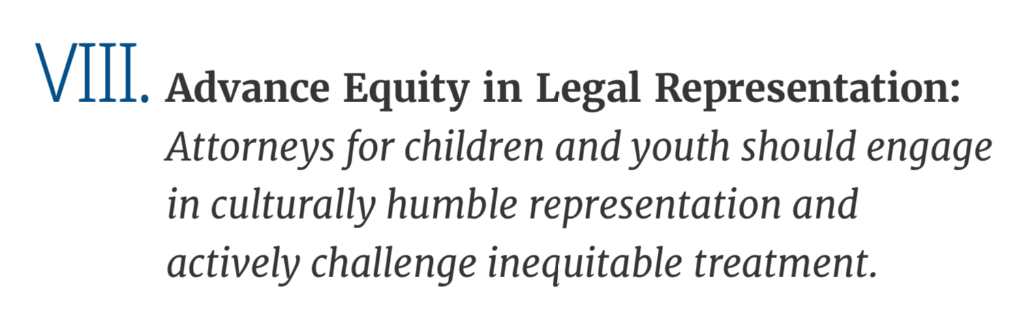
The “What”… | …and the “How”
Equity (Rules 2.3 & 6.4) Knowledgeable about the impact of systemic racism, implicit, and explicit bias Avoid inserting personal values and beliefs | Elevated equity as co-equal to other 9 principles Supervision, peer feedback and expert consultation as tools to check bias Particularly scrutiny around family separation recommendations
Notes:
An AC member shared: “[Attorneys] should know the youth’s religion, ethnicity, cultural background, gender identity and sexual orientation, language barriers, how youth of color and those who have immigration status navigate through the world. Without this information, their care plan will cause more harm than good; without taking these things into consideration, how are they setting up youth for success?”
Attorneys must uncover what triggers their biases and do the personal work in order to develop a process that uses objective criteria to guide their advocacy and decision making
Attorneys should be knowledgeable about the impacts of (what's in the bullet point) and how that may have affected anf affects their client
Cultural humility is a fundamental aspect of attorney competency, attorneys should explore their client's identity: “Youth come from somewhere, they don’t just land somewhere. Just because the people they’re living with [have a] culture that may be different doesn’t mean theirs should be cut out.”

Slide 45
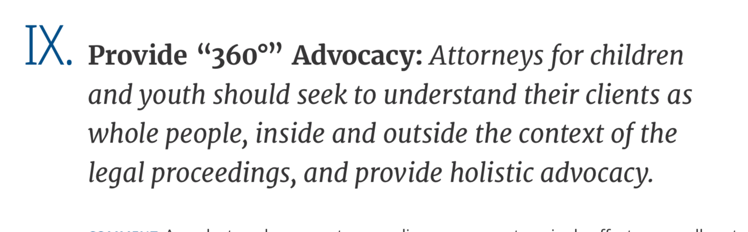
The “What”… | …and the “How”
"Enter the child's world" Ask about safety, address mental and physical well-being Building a youth up | Safety in least restrictive environment “Normalcy” activities Client counseling regarding all permanency pathways and consequences Holistic legal representation; safeguards against “crossover” (Rule 1.2)
Notes:
“Attorneys should always ask, ‘do you feel safe? Do you have the things you need?”
Permanency options-provide robust and unbiased information
“It’s about building [youth] up! Not treating them like broken china or a tragedy or a sob story. Someone that will walk the walk with them.”
Normalcy-advocating for this consistently

Slide 46
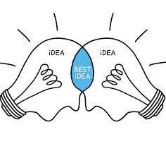
Collaborative Skills
“If I could change one thing, it would be that attorneys develop more of a relationship with the youth and work with other people on the youth’s team (social worker, etc.) to help get a better understanding
of what the youth wants.”
NACC ADVISORY COUNCIL MEMBER
Relationship-building
Diplomacy
Consensus-building
Compromise
Negotiation
Formal and informal mediation

Slide 47
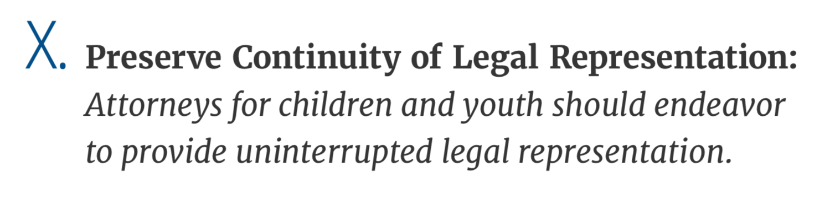
The “What”… | …and the “How”
Proactive planning Implementing self-care Build a professional partnership | Duty of self-care or the attorney to ensure sustainability in field Plans for attorney unavailability and communication with client (Rule 1.16) Records retention until clients 30th birthday
Notes:
45 min
“It’s important for an attorney to build professional partnership [with the youth]. They arenot the youth’s friend.”
It's okay to be friendly without being a friend

Slide 48
Improving QLR: Challenges
Overcoming local culture barriers – “That’s how we do it here”
Incentivizing the practice of child welfare law
Buy-in from local influencers and decision-makers
Geographical challenges
Capacity – so many attorneys, so few working on QLR from a systems level
THIS IS WHERE YOU COME IN!

Slide 49
Improving QLR: What can you do
Case-level advocacy
  The courtroom as a classroom
  Use the available checks and balances
  Stay on top of cases in between hearings, and if an issue arises, file a motion and request a hearing.
Local systems improvement
  Stakeholder meetings
  Appointed attorney standards and policy manual
  Build relationships
  Communicate statutory ideas or challenges up the chain
Notes:
Checks and balances: Create a record, effective cross, subpoena witnesses, file motions, appeal, 15-11-103, 104, consult the bar

Slide 50
Regional Delegates
Communicate child welfare law news and developments
Recruit attorneys to and CWLS certification
Facilitate access to resources, including case law updates, form orders/pleadings, case staffing (groups.io)
Demonstrate high quality legal representation in and out of court
Encourage the use of appellate practice
Work with courts to establish standards for attorneys and create/maintain independence between court and advocate
Advocate for increased pay and established standards for dependency attorneys
Help establish and facilitate local trainings and stakeholder meetings
Communicate up the chain and seek assistance for local barriers to provision of HQLR if local efforts to resolve are not successful
Notes:
Checks and balances: Create a record, effective cross, subpoena witnesses, file motions, appeal, 15-11-103, 104, consult the bar

Slide 51
THANK YOU!
Jen Carreras, CWLS
Deputy Director
Georgia Office of the Child Advocate
jcarreras@oca.ga.gov
404-545-0202

